Slide 1

Introduction to Data Science With
OLGUN AYDIN
Lead Data Analyst-
olgun.aydin@zingat.com
info@olgunaydin.com

Slide 2
Outline
The R
Fundementals
Vectors & Matrix
Import & Export Data
Probablities ,Distributions, Random Numbers
Descriptive Statistics & Graphs
Scripts
Applications
Correlation & Regression Analysis
Clustering
Time Series Analysis
Parametric / Non-Parametric Analysis

Slide 3
The R
R is a statistical computer program made available through the Internet under the General Public License (GPL).
That is, it is supplied with a license that allows you to use it freely, distribute it, or even sell it, as long asthe receiver has the same rights and the source code is freely available.
R provides an environment in which you can perform statistical analysis and produce graphics.

Slide 4
The R
https://www.r-project.org/
https://cran.r-project.org/
https://www.rstudio.com/
https://journal.r-project.org/
http://www.inside-r.org/
http://www.r-bloggers.com/

Slide 5
Vectors & Matrix
One of the simplest possible tasks in R is to enter an arithmetic expression and receive a result.
> 2 + 2
[1] 4
> exp(-2)
[1] 0.1353353
> x <- 2
> x
[1] 2
> x + x
[1] 4

Slide 6
Vectors & Matrix
A data vector is simply an array of numbers, and a vector variable can be constructed like this:
> weight <- c(60, 72, 57, 90, 95, 72)
> weight
[1] 60 72 57 90 95 72
The body mass index (BMI) is defined for each person as the weight in kilograms divided by the square of the height in meters. This could be calculated as follows:
height <- c(1.75, 1.80, 1.65, 1.90, 1.74, 1.91)
> bmi <- weight/height^2
> bmi
[1] 19.59184 22.22222 20.93664 24.93075 31.37799 19.73630

Slide 7
Vectors & Matrix
It’s possible to concatenate vectors of more than one element as in
> x <- c(1, 2, 3)
> y <- c(10, 20)
> c(x, y, 5)
[1] 1 2 3 10 20 5
>length(c(x, y, 5))
[1] 6
It is also possible to assign names to the elements. This modifies the way the vector is printed and is often used for display purposes.
> x <- c(name=“Olgun", surname=“Aydin", comp=“REIDIN")
> x
name surname comp
“Olgun" “Aydin" “REIDIN"

Slide 8
Vectors & Matrix
The second function, seq (“sequence”), is used for equidistant series of numbers. Writing
> seq(4,9)
[1] 4 5 6 7 8 9
The integers from 4 to 9. If you want a sequence in jumps of 2, write
> seq(4,10,2)
[1] 4 6 8 10
The rep function is often used for things such as group codes: If it is known that the first 10 observations are men and the last 15 are women,you can use
> rep(1:2,c(10,15))
[1] 1 1 1 1 1 1 1 1 1 1 2 2 2 2 2 2 2 2 2 2 2 2 2 2 2

Slide 9
Vectors & Matrix
A convenient way to create matrices is to use the matrix function:
a<-matrix(1:9,3,3)
> a
[,1] [,2] [,3]
[1,] 1 4 7
[2,] 2 5 8
[3,] 3 6 9
Product a with its transpose
a%*%t(a)
[,1] [,2] [,3]
[1,] 66 78 90
[2,] 78 93 108
[3,] 90 108 126

Slide 10
Vectors & Matrix
A convenient way to create matrices is to use the matrix function:
a<-matrix(1:9,3,3)
> a
[,1] [,2] [,3]
[1,] 1 4 7
[2,] 2 5 8
[3,] 3 6 9
Product a with its transpose
a%*%t(a)
[,1] [,2] [,3]
[1,] 66 78 90
[2,] 78 93 108
[3,] 90 108 126

Slide 11
Vectors & Matrix
Inverse of a calculated as follows:
solve(a)
To get dimension of matrix
> dim(a)
[1] 3 3
Can “glue” vectors together, columnwise or rowwise, using the cbind and rbind functions.
> cbind(A=1:4,B=5:8,C=9:12)
A B C
[1,] 1 5 9
[2,] 2 6 10
[3,] 3 7 11
[4,] 4 8 12

Slide 12
Vectors & Matrix
> rbind(A=1:4,B=5:8,C=9:12)
[,1] [,2] [,3] [,4]
A 1 2 3 4
B 5 6 7 8
C 9 10 11 12

Slide 13
Import & Export Data
Get working directory
getwd()
[1] "C:/Users/ol/Desktop“
Set working directory
>setwd("C:/Users/ol/Documents")
getwd()
[1] "C:/Users/ol/Documents”

Slide 14
Import & Export Data
From A Comma Delimited Text File
mydata <- read.table("c:/mydata.csv", header=TRUE,
sep=",", row.names="id")
From Excel
library(xlsx)
mydata <- read.xlsx("c:/myexcel.xlsx", sheetName=mysheet")
From SPSS
library(Hmisc)
mydata <- spss.get("c:/mydata.por“,use.value.labels=TRUE)

Slide 15
Import & Export Data
List files in working directory
>list.files()
[1] "adaptive7_h200.csv"
[2] "adaptive8_h100.csv"
[3] "adaptive8_h250.csv"
[4] "adaptive9_h200.csv"
[5] "adaptive9_h200_2.csv"
[6] "adaptive9_h300.csv"
List objects in current workspace
ls()
[1] "a" "boundary" "data" "smry"

Slide 16
Import & Export Data
Show first 2 rows of the matrix
> head(data,2)
CityID CityName CountyID CountyName ActivityTypeID ActivityType PropertySubTypeID PropertySubTypeName AmountSize to_char
1 231 İstanbul 248 Kadıköy 11 Sales 119 Office 6141.429 2015
2 231 İstanbul 248 Kadıköy 11 Sales 119 Office 5646.226 2015
Show coloumn names of matrix
>colnames(data)
[1] "CityID" "CityName" "CountyID" "CountyName" "ActivityTypeID"
[6] "ActivityType" "PropertySubTypeID" "PropertySubTypeName" "AmountSize" "to_char"
Show first 2 rows of “AmountSize” coloumn
head(data$AmountSize,2)
[1] 6141.429 5646.226

Slide 17
Probablities &Distributions&Random Numbers
In R, you can simulate these situations with the sample function. If you want to pick five numbers at random from the set 1:40, then you can write
> sample(1:40,5)
[1] 4 30 28 40 13
There are five possibilities for the first number, and for each of these there are four possibilities for the second, and so forth; that is, the number is 5 × 4 × 3 × 2 × 1. This number is also written as 5! (5 factorial).
>prod(5:1)
[1] 120

Slide 18
Probablities &Distributions&Random Numbers
So all we need to do is to calculate the number of ways to choose 5 numbers out of 40.
> 1/choose(40,5)
[1] 1.519738e-06
way of creating the plot is to use curve as follows:
> curve(dnorm(x), from=-4, to=4)
For discrete distributions, where variables can take on only distinct values,it is preferable to draw a pin diagram, here for the binomial distribution with n = 50 and p = 0.33
> x <- 0:50
> plot(x,dbinom(x,size=50,prob=.33),type="h")

Slide 19
Probablities &Distributions&Random Numbers
Say that it is known that some biochemical measure in healthy individuals is well described by a normal distribution with a mean of 132 and a standard deviation of 13. Then, if a patient has a value of less than 160, there is
> 1-pnorm(160,mean=132,sd=13)
[1] 0.01562612
> pnorm(1.96)
[1] 0.9750021
> 1-pnorm(1.96)
[1] 0.0249979
> qnorm(0.975)
[1] 1.959964

Slide 20
Probablities &Distributions&Random Numbers
The use of the functions that generate random numbers is straightforward. The first argument specifies the number of random numbers to compute, and the bsequent arguments are similar to those for other functions related to the same distributions. For instance,
> rnorm(10)
[1] -0.2996466 -0.1718510 -0.1955634 1.2280843 -2.6074190
[6] -0.2999453 -0.4655102 -1.5680666 1.2545876 -1.8028839
> rnorm(10,mean=7,sd=5)
[1] 8.934983 8.611855 4.675578 3.670129 4.223117 5.484290
[7] 12.141946 8.057541 -2.893164 13.590586
> rbinom(10,size=20,prob=.5)
[1] 12 11 10 8 11 8 11 8 8 13

Slide 21
Descriptive Statistics & Graphs
It is easy to calculate simple summary statistics with R. Here is how to calculate the mean, standard deviation, variance, and median.
> x <- rnorm(50)
> mean(x)
[1] 0.03301363
> sd(x)
[1] 1.069454
> var(x)
[1] 1.143731
> median(x)
[1] -0.08682795

Slide 22
Descriptive Statistics & Graphs
Empirical quantiles may be obtained with the function quantile like this:
>quantile(data$AmountSize)
0% 25% 50% 75% 100%
0.5685 360.5000 588.4818 929.3559 33636.3636
Summary statistics
>summary(data$AmountSize)
Min. 1st Qu. Median Mean 3rd Qu. Max.
0.57 360.50 588.50 792.80 929.40 33640.00

Slide 23
Descriptive Statistics & Graphs
Empirical quantiles may be obtained with the function quantile like this:
>quantile(data$AmountSize)
0% 25% 50% 75% 100%
0.5685 360.5000 588.4818 929.3559 33636.3636
Summary statistics
>summary(data$AmountSize)
Min. 1st Qu. Median Mean 3rd Qu. Max.
0.57 360.50 588.50 792.80 929.40 33640.00
Learn how many rows of AmountSize less than 1000 USD
> length(data$AmountSize[data$AmountSize<1000])
[1] 281621

Slide 24
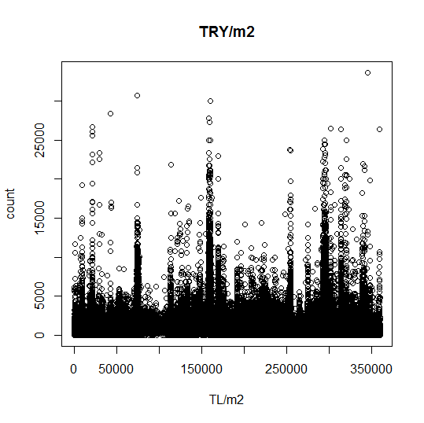
Descriptive Statistics & Graphs
Draw plot of AmountSize
>plot(data$AmountSize,main="TRY/m2",xlab="TL/m2",ylab="count")

Slide 25
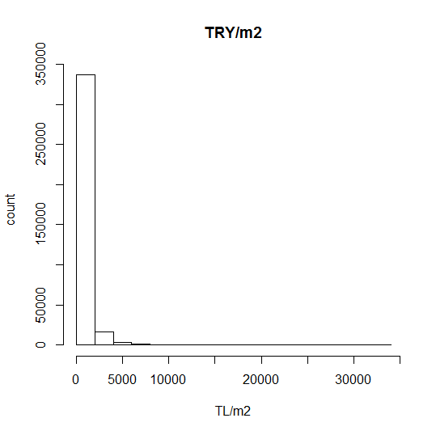
Descriptive Statistics & Graphs
Draw histogram of AmountSize
>hist(data$AmountSize,main="TRY/m2",xlab="TL/m2",ylab="count")

Slide 26
Summarize
The doBy package provides much of the functionality of SAS PROC SUMMARY. It defines the desired table using a model formula and a function. Here is a simple example.
>library(doBy)
>summaryBy(mpg + wt ~ cyl + vs, data = mtcars, FUN = function(x) { c(m = mean(x), s = sd(x)) } )

Slide 27
Summarize
boundary<- function(x)
{
Pricetran<-log(x)
meantdata<-mean(Pricetran)
stdtdata<-sd(Pricetran)
skw<-skewness(x)
kurt<-kurtosis(x)
UpB_2_51<-exp(meantdata+2.51*stdtdata)
LoB_2_51<-exp(meantdata-2.51*stdtdata)
return(c(skw,kurt,LoB_2_51,UpB_2_51)
}
smry <- summaryBy(AmountSize~CityID+CityName+CountyID+CountyName+ActivityTypeID+ActivityType+PropertySubTypeName, FUN=boundary, data=data)

Slide 28
Applications
Correlation & Regression Analysis
Clustering
Time Series Analysis
Parametric / Non-Parametric Analysis

